Slide 1
SOLILOQUY
COMPANY NAME
Home
About us
Services
Blog
Portfolio
Contact

Slide 2
ABOUT US
COMPANY NAME
Home
About us
Services
Blog
Portfolio
Contact
22pmc139
Nandhu Jayan

Slide 3
Abstract
COMPANY NAME
Home
About us
Services
Blog
Portfolio
Contact
Soliloquy is a Django-based social media website project called Soliloquy, designed specifically to provide support and a safe space for individuals experiencing sadness and depression in their lives. The platform aims to create a supportive online community where users can find solace, connect with like-minded individuals, share their thoughts and feelings, and access valuable resources to aid in their journey towards emotional well-being.
Soliloquy focuses on providing a compassionate and empathetic environment, where users can openly express their emotions and find support from others who can relate to their experiences. Through a combination of interactive features and curated content, the platform aims to foster a sense of belonging and encourage positive interactions.
By leveraging the Django framework, Soliloquy ensures efficient data management and user authentication, contributing to a secure and reliable user experience. Django's robust ORM capabilities facilitate seamless integration with the database, allowing for efficient storage and retrieval of user-generated content. Additionally, the project utilizes Django's templating system and URL routing to create a user-friendly and responsive web interface.

Slide 4
Client requirements
SOLILOQUY
Home
About us
Services
Blog
Portfolio
Contact
1. User can Register and login
2. User can view the home page
3. User can view the post view page
4. User can add post
5. User can like and comment on the post.
6. User can save others post.
7. User can sent friend reuqest.
8. User can follow others.
9. User can approve friend request
10. User can sent messages to friends.
11. User can watch who all are the friends of the other user.
12. User can recieve messages
13. User can logout
14. Users can view the liked post.
15. AI chatbot

Slide 5
User Profiles
Post Creation
User Registration
Friend Connections
Messaging System
Interactions and Engagement
Home
About us
Services
Blog
Portfolio
Contact
Features and highlights
Users should be able to create an account and log in securely
Implement authentication mechanisms to ensure user privacy and security.
Each user should have a profile page that displays their basic information and activity.
Users can update their profile information and add a profile picture
Users can create and publish posts containing text.
Implement a user-friendly interface for composing and formatting posts.
Enable users to share their posts with the community or limit the visibility to specific audiences.
Users can send friend requests and accept/reject requests from others.
Implement a system to manage friend connections and display a user's list of friends.
Users can send private messages to their friends.
Implement a real-time messaging system to facilitate private conversations.
Chatbot feature
Users can like, comment on posts created by others.
Implement real-time notifications to inform users about interactions on their posts.
You can save post

Slide 6
Third-Party Libraries:
COMPANY NAME
Home
About us
Services
Blog
Portfolio
Contact
agora-token-builder 1.0.0
asgiref 3.4.1
attrs 21.2.0
autobahn 21.3.1
Automat 22.10.0
certifi 2021.5.30
cffi 1.14.6
channels 3.0.4
charset-normalizer 2.0.4
constantly 15.1.0
cryptography 3.4.7
daphne 3.0.2
defusedxml 0.7.1
Django 4.0.7
django-allauth 0.45.0
django-ckeditor 6.1.0
django-cleanup 5.2.0
django-crispy-forms 1.12.0
django-jazzmin 2.6.0
django-js-asset 1.2.2
hyperlink 21.0.0
idna 3.2
incremental 21.3.0
oauthlib 3.1.1
Pillow 9.0.1
pip 21.3.1
psycopg2 2.9.1
pyasn1 0.4.8
pyasn1-modules 0.2.8

Slide 7
Architecture of your project
COMPANY NAME
Home
About us
Services
Blog
Portfolio
Contact
Model:
The Model represents the data and the business logic of the application.
View:
The View is responsible for rendering the user interface and presenting the data to the users.
Templates:
Templates are responsible for generating dynamic HTML pages based on the data received from the views.
Static Files:
Static files such as CSS, JavaScript, and images are used to enhance the user interface and add interactivity.
Middleware:
Middleware components intercept and process requests and responses globally.
Additional Components:
Soliloquy may incorporate additional components based on specific requirements.

Slide 8
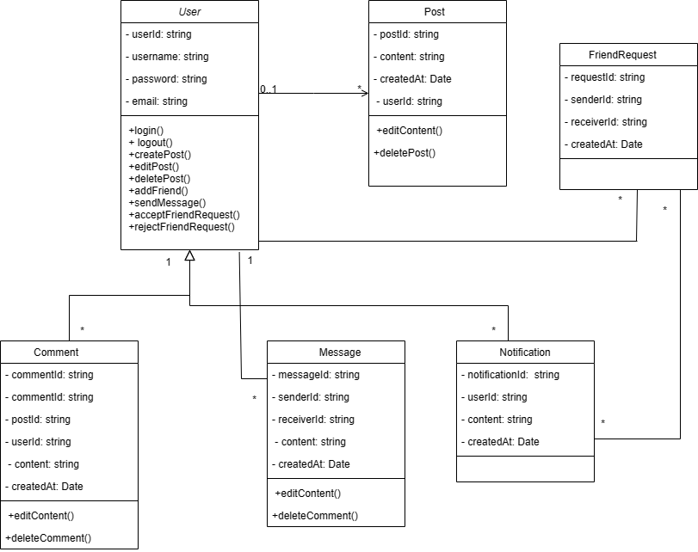
CLASS DIAGRAM

Slide 9
Challenges faced during the development
SOLILOQUY
Home
About us
Services
Blog
Portfolio
Contact
User Privacy and Data Security:
Implementing robust security measures to
protect user data and ensure privacy can
be challenging.
Emotional Well-being Considerations:
Developing a platform for individuals
experiencing sadness and depression requires
sensitivity and empathy.
Community Management and Content
Moderation:
Building and maintaining a safe
Scalability and Performance:
As the user base grows, ensuring the platform
can handle increasing traffic and maintain
acceptable performance becomes crucial.
Real-time Interactions and Notifications:
Implementing real-time features like messaging,
notifications, and updates can introduce
complexities.
Designing Intuitive User Interfaces:
Creating user-friendly interfaces that are
intuitive and accessible is a constant challenge.

Slide 10
FUTURE ENHANCEMENT
SOLILOQUY
Home
About us
Services
Blog
Portfolio
Contact
Support Groups and Forums:
Create support groups or forums where users
can connect and engage in discussions on
specific topics related to sadness, depression,
and emotional well-being.
Personalized Recommendations:
Develop personalized recommendation systems
that suggest relevant content, resources, or
connections based on user preferences,
interests, and browsing history.
Mobile Application Development:
Build mobile applications for Soliloquy to offer a
more convenient and accessible user experience
on smartphones and tablets.
Machine Learning-Based Sentiment Analysis:
Enhance the sentiment analysis feature by
incorporating machine learning algorithms.
Advanced Community Moderation Tools:
Implement advanced content moderation tools
to efficiently detect and handle inappropriate or
harmful content.
Integration with Mental Health Professionals:
Collaborate with mental health professionals to
provide expert guidance and resources within
the platform.

Slide 11
CONCLUSION
SOLILOQUY
Home
About us
Services
Blog
Portfolio
Contact
In conclusion, Soliloquy is a social media website project developed using Django, aimed at providing a safe and supportive community for individuals experiencing sadness and depression. The project focuses on creating a platform where users can connect, share their thoughts and emotions, and receive support from like-minded individuals.
The project incorporates essential features such as user profiles, post creation and sharing, interactions and engagement, real-time notifications, friend connections, private messaging, a resource section, and sentiment analysis. These features aim to foster a sense of community, provide a supportive environment, and offer valuable resources for users' emotional well-being.

Slide 12
REFERENCES
SOLILOQUY
Home
About us
Services
Blog
Portfolio
Contact
https://www.kommunicate.io/
https://chat.openai.com
https://testdriven.io/blog/django-channels/#:~:text=Django%20Channels%20%28or%20just%20Channels%29%20extends%20the%20built-in,MQTT%20%28IoT%29%2C%20chatbots%2C%20radios%2C%20and%20other%20real-time%20applications.
https://codewithstein.com/django-realtime-chat-app-tutorial-simple-django-tutorial-with-channels-and-redis/
(685) Build a Social Media App with Django – Python Web Framework Tutorial - YouTube

Slide 13
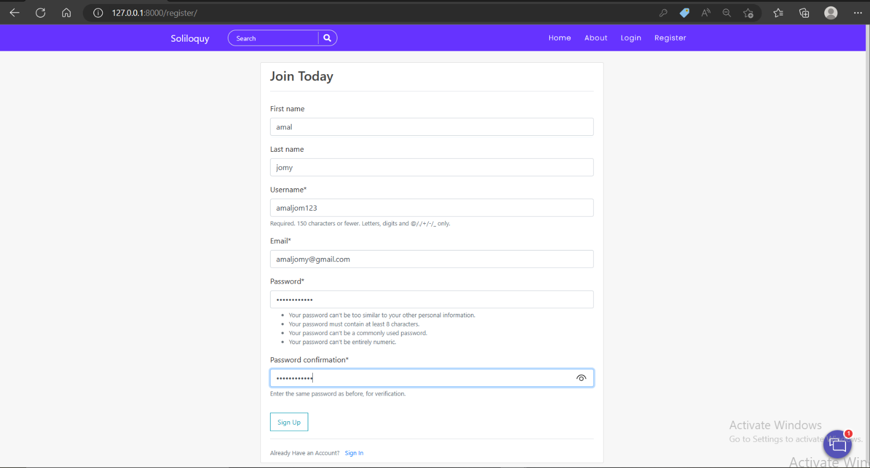
SCREENSHOTS
REGISTRATION PAGE

Slide 14
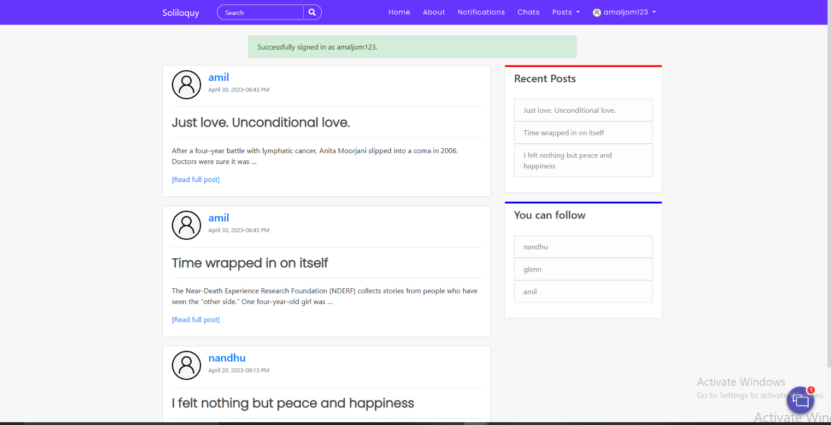
FEED

Slide 15
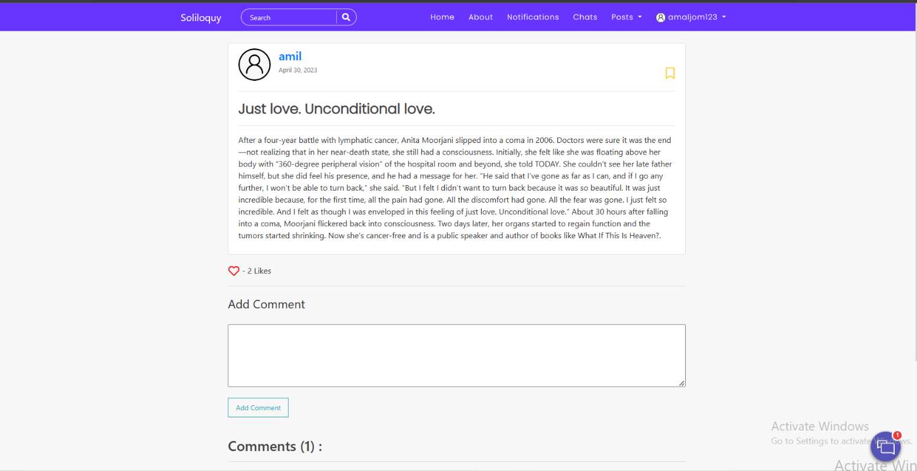
VIEW POST

Slide 16
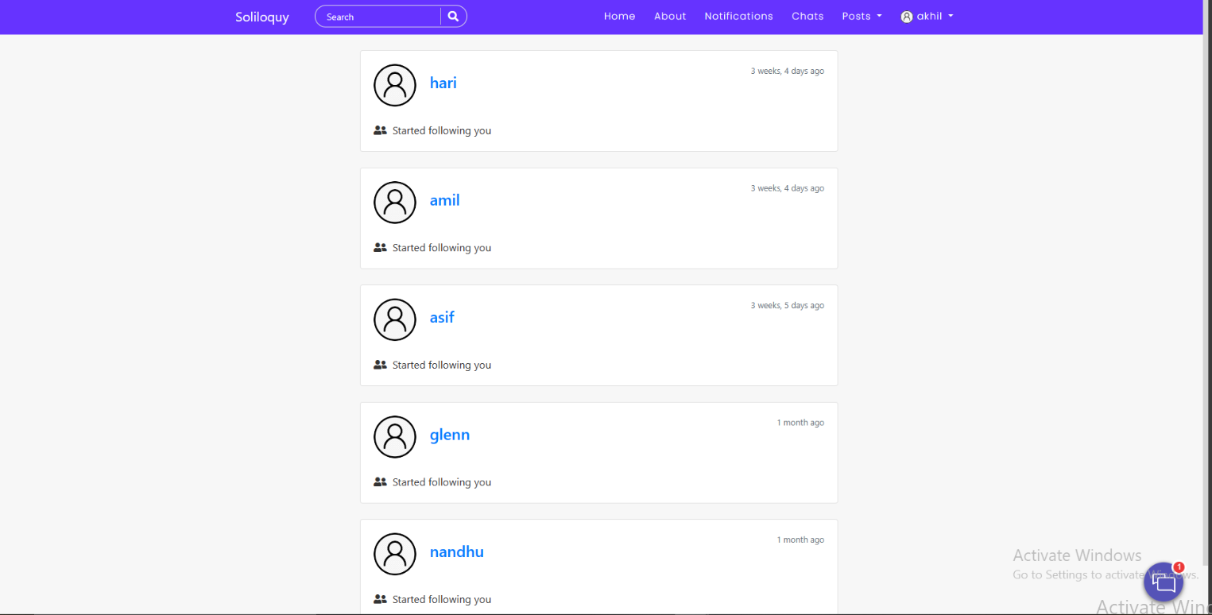
NOTIFICATION

Slide 17
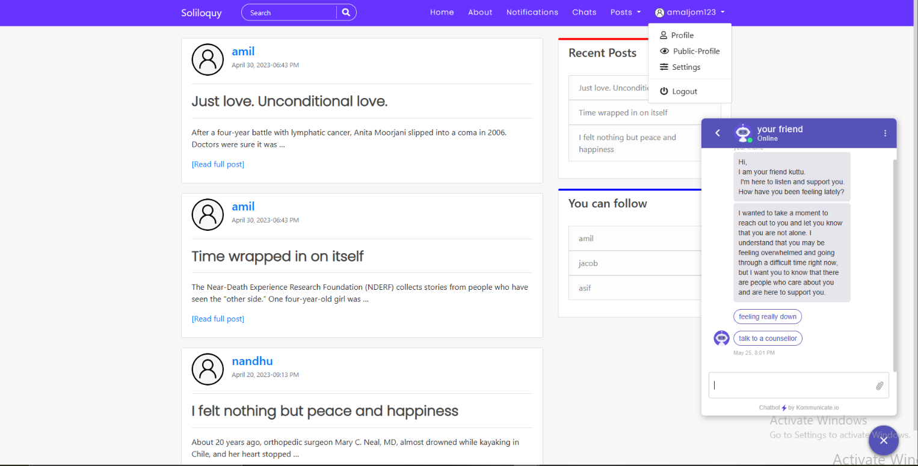
AI CHAT BOT

Slide 18
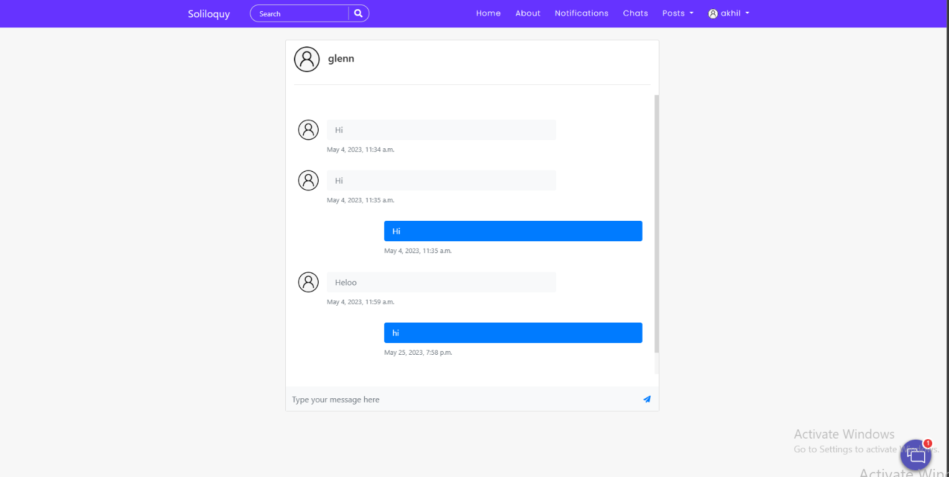
MESSAGING

Slide 19
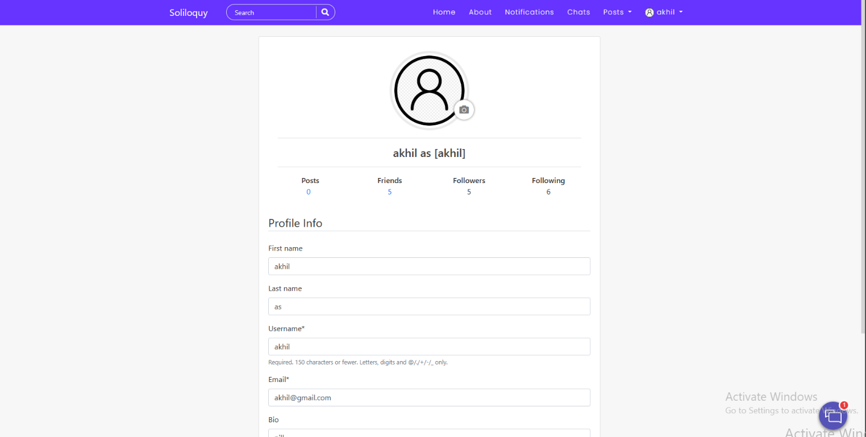
PROFILE UPDATE

Slide 20
THANKS!

